Slide 1

Case Study: Intelligent Systems (WS25/26)
Predictive Maintenance of Milling Machines
Lecturer: Hamidreza Heidari
Members: Irtaza Janjua, Soman Tariq, Sadeed Ahmad, Usama Ali

Slide 2
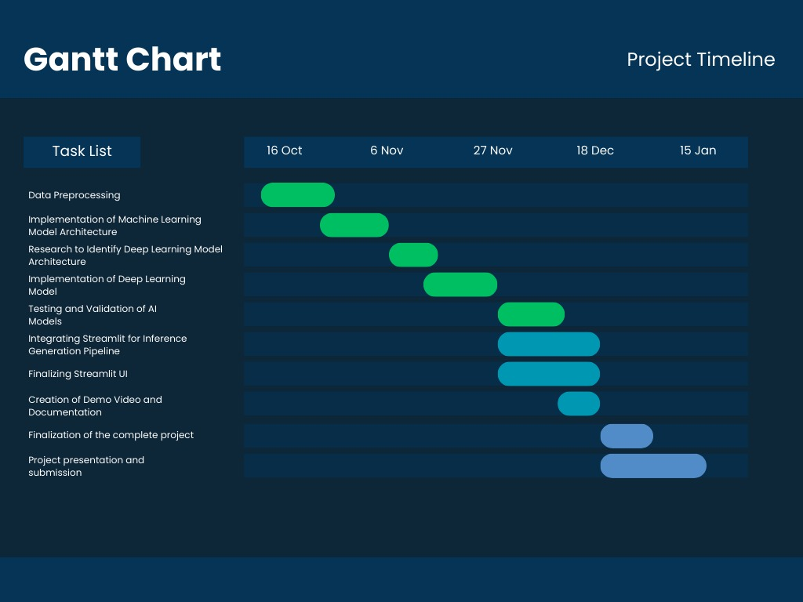
Project Timeline

Slide 3
Project Overview
Predictive Maintenance (PdM) for milling machines using sensor data
Goal: Predict machine failure and identify failure patterns early
Motivation: Reduce costly unplanned downtime and enable Industry 4.0 data-driven maintenance
Dataset: UCI Predictive Maintenance dataset

Slide 4
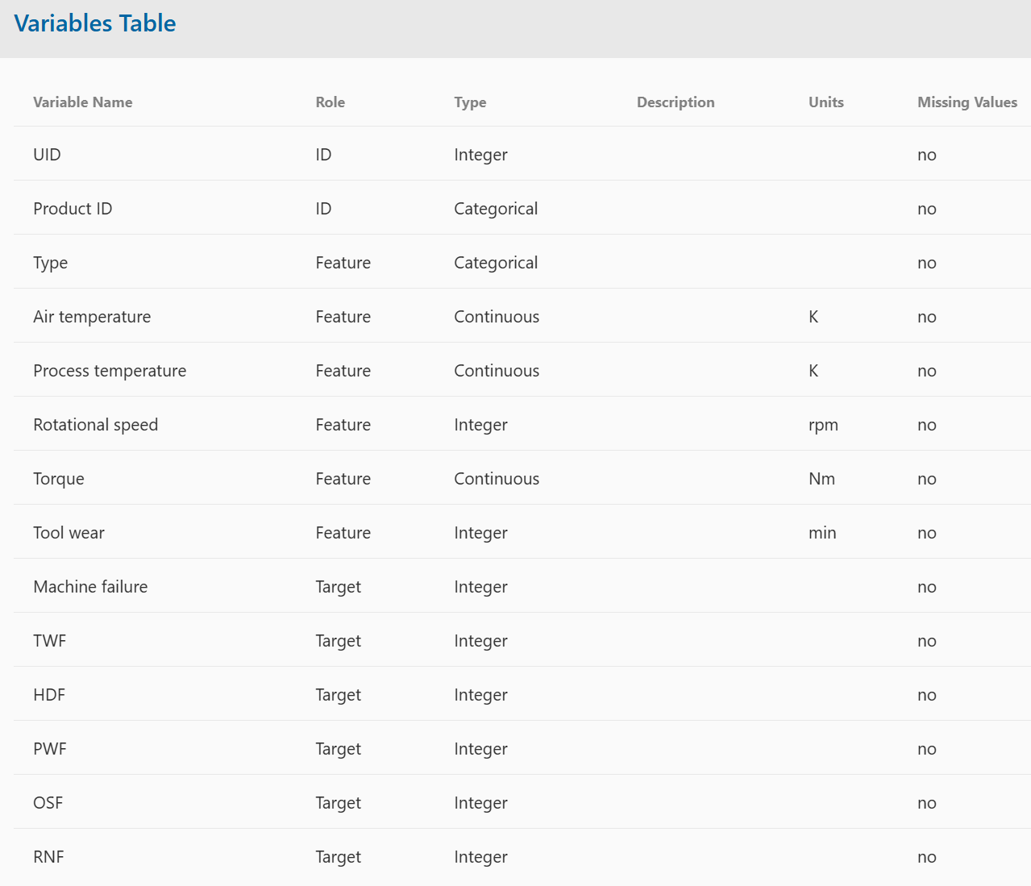
Recap: Data Understanding
10,000 samples (unique IDs).
Type: Quality categories — Low (50%), Medium (30%), High (20%).
Air Temperature (K)
Process Temperature (K)
Rotational Speed (rpm)
Torque (Nm)
Tool Wear (min)
Targets:
Target 1: Machine Failure (Yes/No)
Target 2: Failure Type (categorical)
Tool wear failure (TWF)
Heat dissipation failure (HDF)
Power failure (PWF)
Overstrain failure (OSF)
Random failures (RNF)

Slide 5
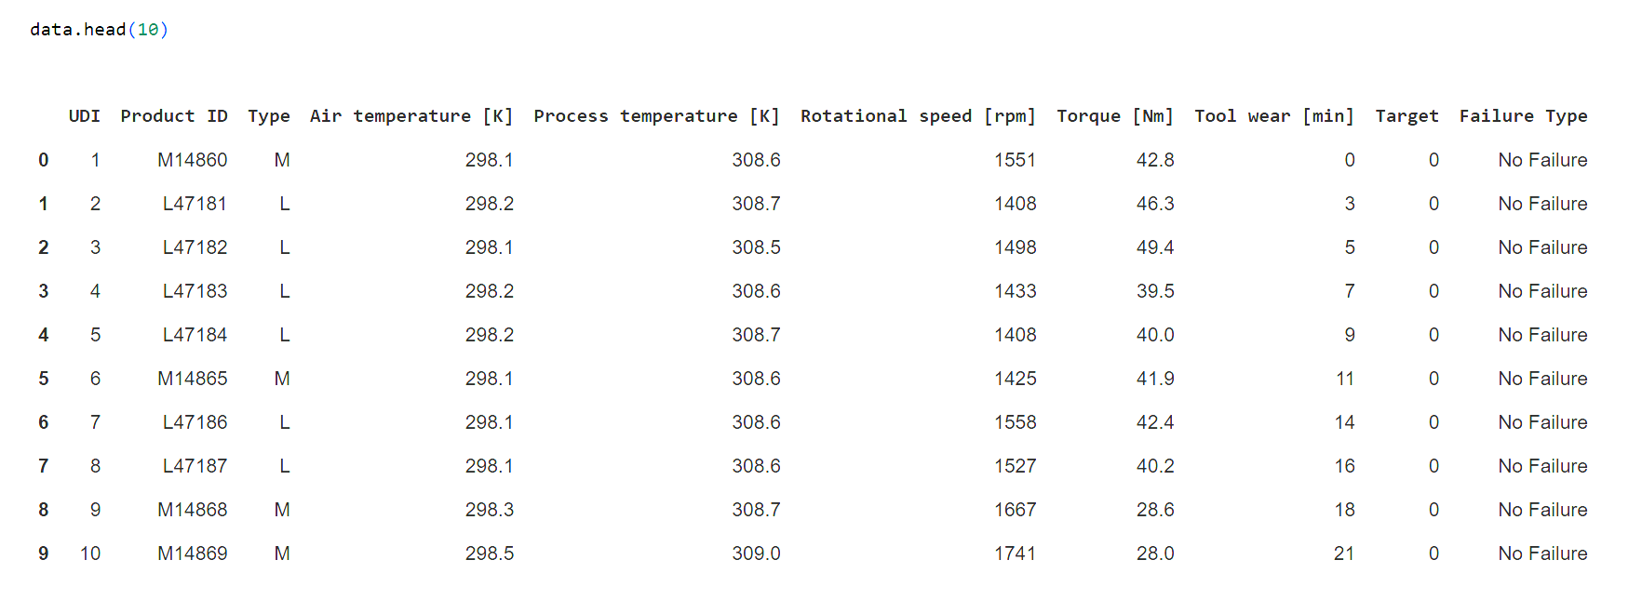
Recap: Data Exploration (CODE)

Slide 6
Recap: Initial Data Exploration
Checked for missing values → none found.
Checked for duplicates → none found.
Identified 6 numeric and 3 categorical features.
Converted numeric columns to float type for consistency.
Removed UDI and Product ID
Found labeling inconsistencies:
Random Failures (RNF) were not marked as machine failures.
Corrected target values to set Target = 1 for RNF.
Removed ambiguous records (9 rows) where Machine failure = 1 but no specific failure cause was given.

Slide 7
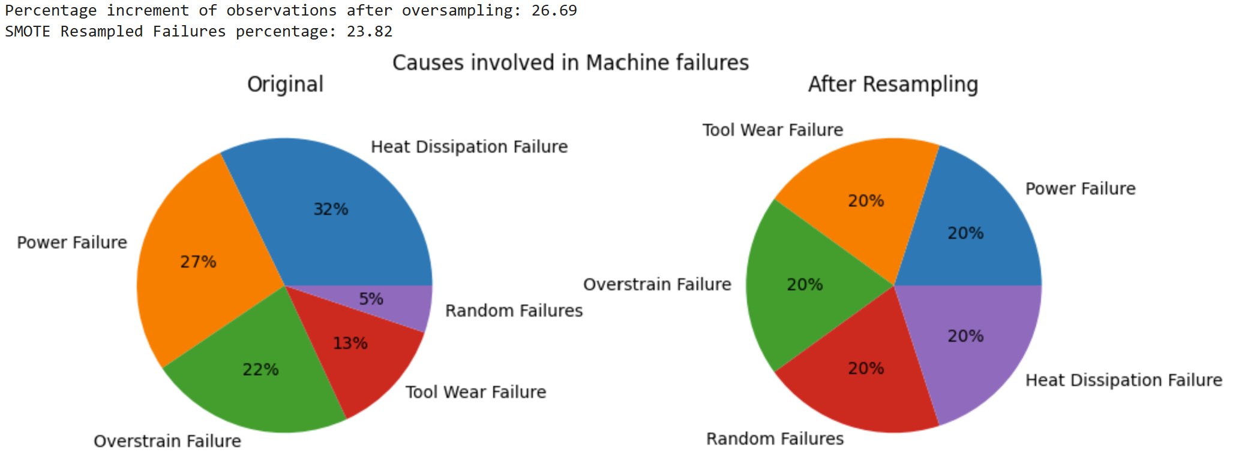
Recap: Handling Class Imbalance (SMOTE)
Only 3.57% of observations were machine failures.
Applied SMOTE (Synthetic Minority Oversampling Technique):
Generated synthetic samples for minority failure modes.
Balanced data to ~75:25 ratio (working:failure).
Achieved uniform representation across all failure types.

Slide 8
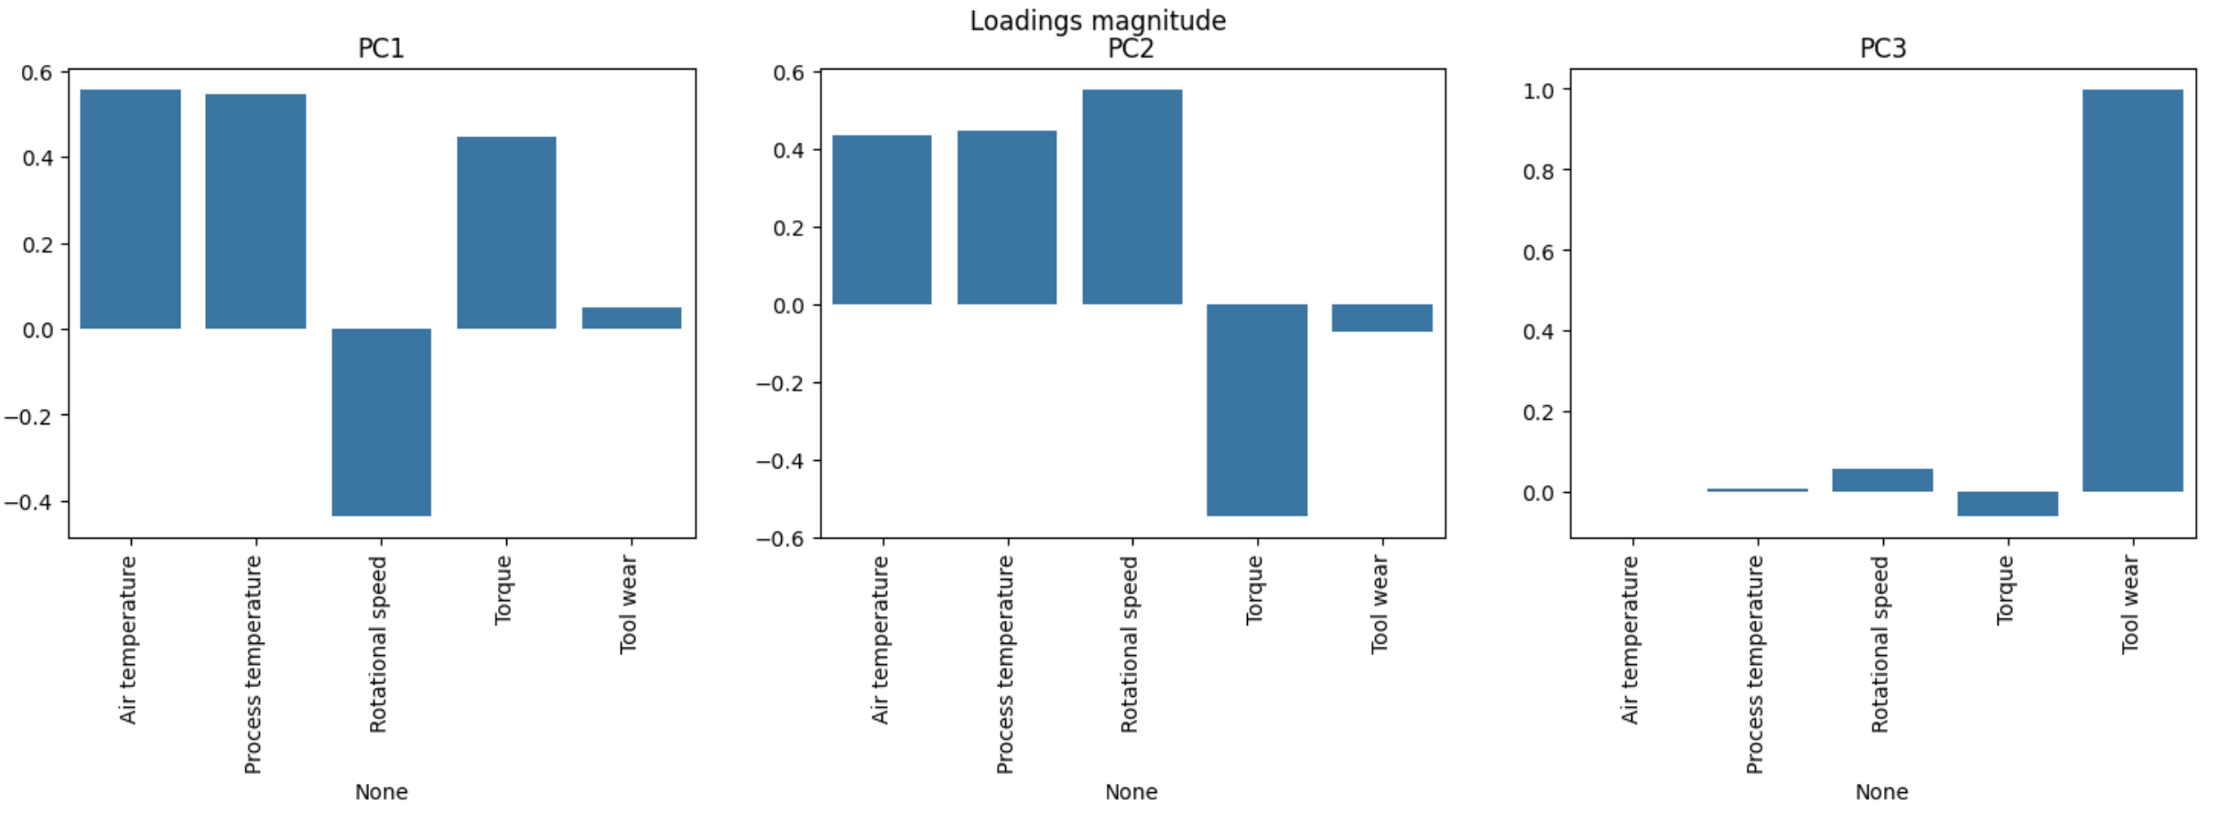
Recap: Principal Component Analysis
Applied Principal Component Analysis (PCA) on numeric features.
Top 3 PCs explain most of the variance.
Interpretation:
PC1 → closely related to the two temperature features
PC2 → can be identified with the machine power, which is the product of Rotational Speed and Torque
PC3 → Tool Wear

Slide 9
Recap: Baseline Model
Selected Random Forest as the baseline due to strong performance in PdM literature.
Robust to noise, handles mixed feature types, and offers interpretability.
Achieved 95.9% accuracy, but the recall on the failure class was only ~88%, which is a significant drawback since missing failures is costly in predictive maintenance.

Slide 10
Motivation for Deep Learning
Literature shows Neural Network Architectures excel in PdM for modeling complex nonlinear patterns in sensor data.
Neural networks can capture higher-order interactions among temperature, torque, speed, and tool wear.
Neural Networks can generalize better under noise and extreme operating conditions typical in industrial data.
Provides a complementary modeling approach to tree-based methods → allows benchmarking and performance comparison.

Slide 11
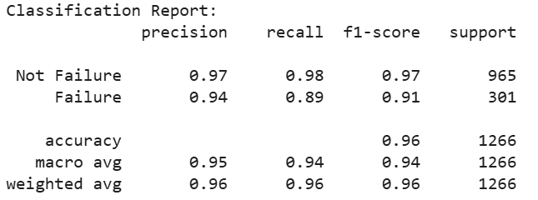
Initial Neural Network Architecture
Implemented a feed-forward Artificial Neural Network
2 hidden layers: 128 → 64 neurons
ReLU activations + Dropout(0.3)
Softmax output layer
Trained with Adam + EarlyStopping

Slide 12
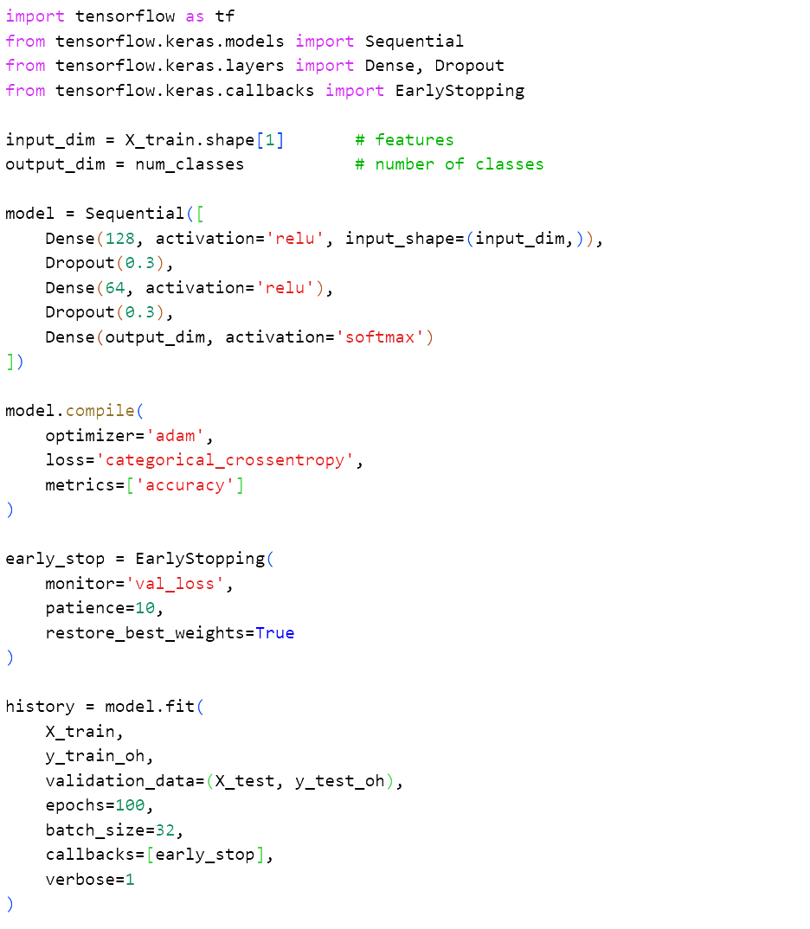
Initial Neural Network Architecture (CODE)

Slide 13
Advanced Neural Network Model
Implemented a deep feed-forward Artificial Neural Network
ANN Architecture: 5 hidden layers with 512 → 256 → 128 → 64 → 32 neurons, followed by a softmax output layer.
Stacked dense layers with:
ReLU activation → prevents vanishing gradients, fast and stable training.
Batch Normalization → stabilizes distributions across layers, speeds convergence.
Dropout → reduces co-adaptation, improves generalization.
L2 weight regularization → penalizes overly large weights, controls model complexity.

Slide 14
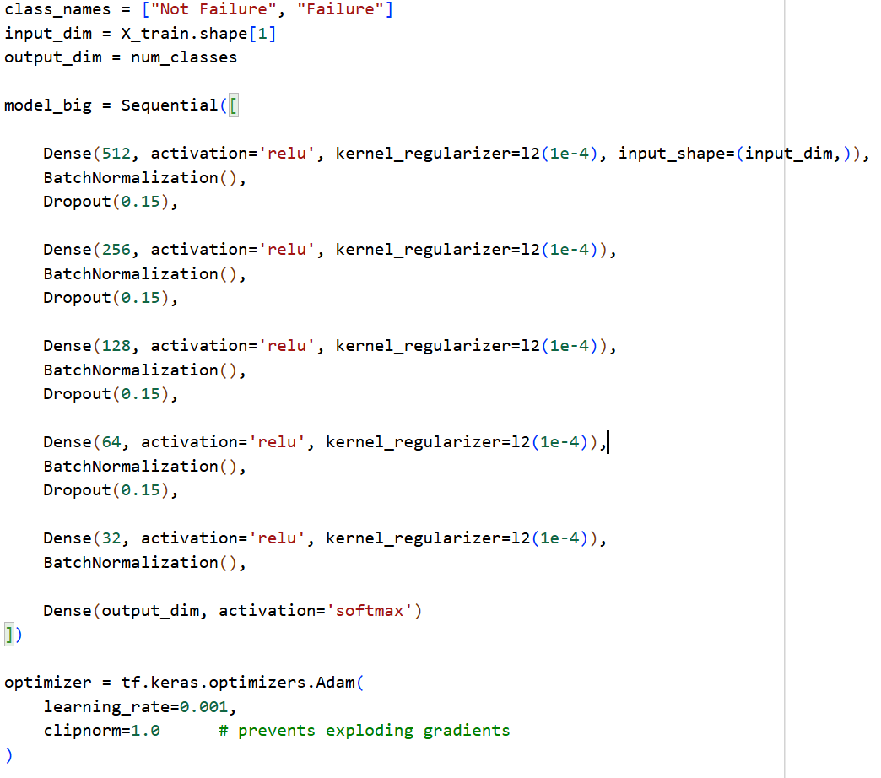
Advanced Neural Network Architecture (CODE)

Slide 15
Training Strategy
Adam optimizer: adapts the learning rate automatically, helping the model learn steadily and efficiently.
Early Stopping: stops training when validation performance no longer improves, preventing overfitting and keeping the best model.
Learning Rate Reduction: lowers the learning rate when progress slows, allowing finer adjustments during later training stages.
Batch size (32): balances training stability and computation speed.
Epoch limit (200): high flexibility, but training usually stops earlier due to Early Stopping.

Slide 16
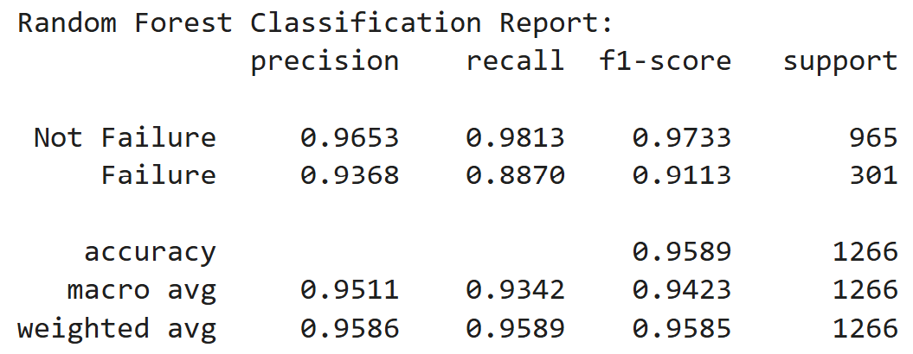
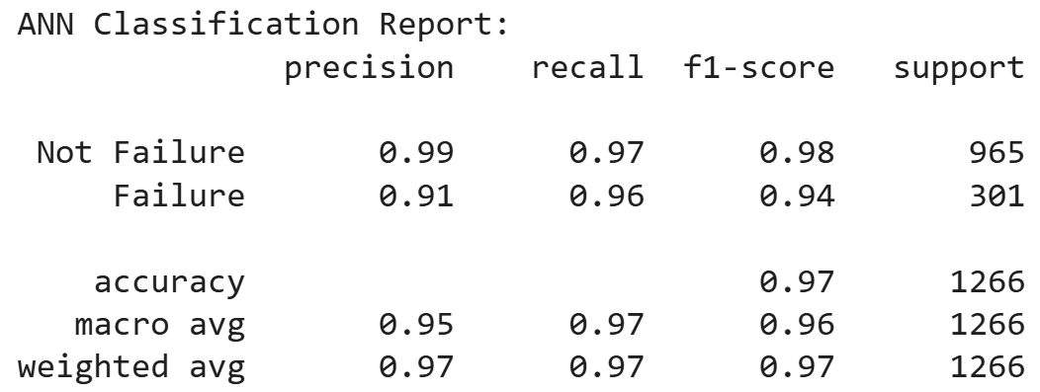
Result Comparison
ANN shows stronger overall performance, improving the accuracy from 95.9% to 96.8%.
The ANN drastically improves recall on the Failure class, which is the single most important metric in predictive maintenance.
RF remains strong and interpretable, but ANN captures deeper nonlinear patterns, especially in rare failure conditions.
ANN provides a better balance between both classes, resulting in higher macro and weighted F1-scores.

Slide 17
Future Work
Move from model training to deployment phase
Build an inference pipeline to process real machine sensor inputs
Develop an interactive PdM dashboard using Streamlit where users can input data and receive predictions

